Slide 1


Study Exchange:
All you need to know to well-prepare

Slide 2


You've applied and have been officially selected, as indicated by your Erasmus+ Decision – WHAT COMES NEXT?
Carrying out the application procedure at the host institution
Applying for Erasmus co-funding
Completing mobility documentation
General preparation: accommodation, health insurance, visa

Slide 3


Applying to the Partner Institution (Application procedures)
Check the host institution´s website and get acquainted with the host institution´s study calendar.
Partner institution reaches out directly to your UP student email with all essential information, such us application instructions, course catalog, etc. (be aware of the deadlines).
Complete required paper work/online forms requested by your host institution (*English Certificate)
Upon successful completion, the host institution will issue you an Acceptance Letter.

Slide 4
Applying for co-financing: Financial Agreement
Once a student is selected for mobility under the call, Erasmus+ financial support is not automatically assigned.
Detailed instructions for applying for Erasmus+ co-funding will be sent to your UP student email by the UP Project Office, which manages all matters related to the scholarship (students going in winter semester will be informed first, students going in summer semester second).
The basis for concluding a financial agreement are Acceptance Letter and signed learning agreement (OLA)
Co-financing Options in a nutshell More info: Annex 3_ Possibilities of co-financing the mobility_KA131_STUDY | Monthly grant: 550€-674€, depending on the country of destination. Support for travel costs based on the distance and mode of travel. Additional funding for students with fever opportunities (250€/month).

Slide 5
Completing mobility documentation
2 core documents:
Online Learning Agreement (OLA)
Tripartite agreement, signed by three parties: you, your study program coordinator and the responsible person at host institution.
Includes your selected courses from abroad and their counterparts at FAMNIT.
Agrees the contents of the mobility and the process of recognition of learning outcomes obtained abroad.
Simultaneously, Application Form for the Conclusion of and Amendments to the Learning Agreement needs to be completed.
Internal form, signed by you, your study program coordinator and FAMNIT Referat.
This internal document serves as an essential basis for recognition procedure of study outcomes carried out at your study exchange.
Includes your selected courses from abroad and their counterparts at FAMNIT.

Slide 6
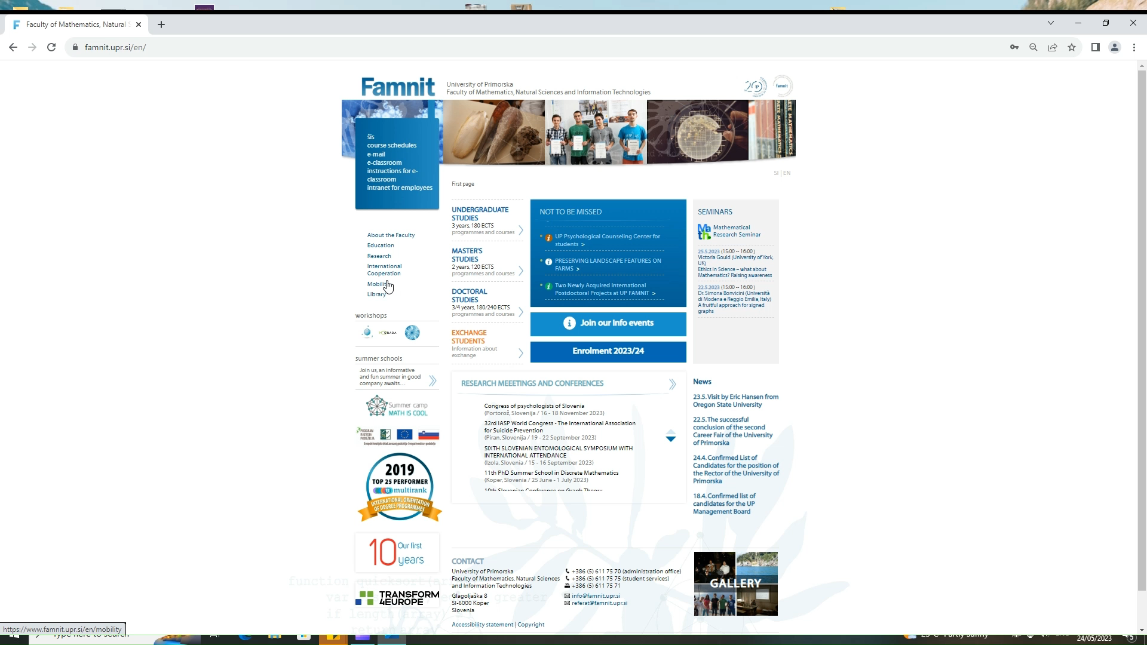
Access to the relevant mobility documentation:

Slide 7


Online Learning Agreement (OLA)
Two step procedure: Login In & Start creating your OLA via https://learning-agreement.eu/
Before you add your signature, make sure to double check the information provided.
Sending Institution Information
Slovenia, University of Primorska
Erasmus code: SI KOPER03
Faculty of Mathematics, Natural Sciences and Information Technologies
Sending Contact Person
Ira Mešiček, UP FAMNIT International Office
international@famnit.upr.si, +386 5 61 17 594
Sending Responsible Person (signatory person)
your study program coordinator

Slide 8
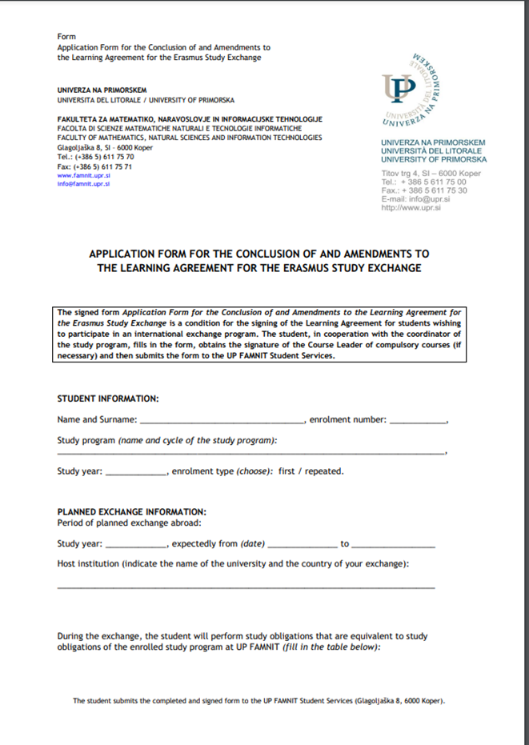
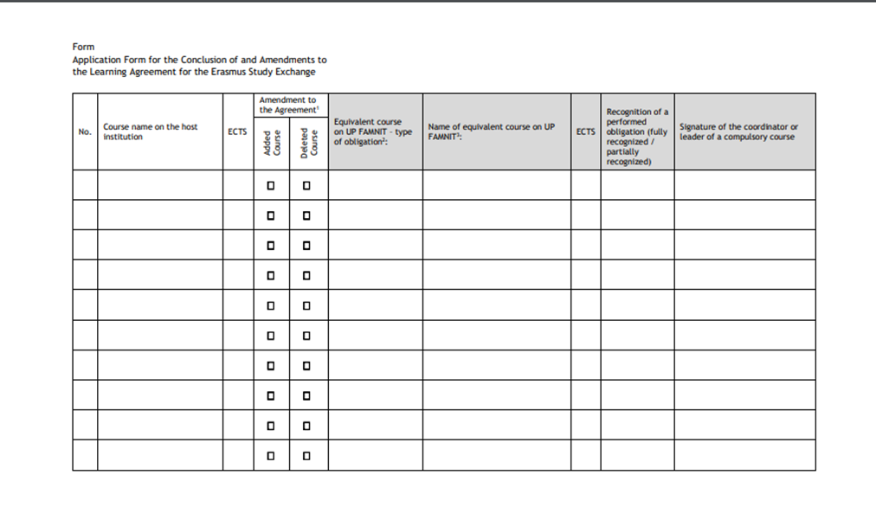
Application Form for the Conclusion of and Amendments to the Learning Agreement

Slide 9
Finalizing Paperwork step by step:
A must-do before you start your study exchange.
Choose courses in accordance to your curriculum - Selected courses and recognition process needs to be identical on both documents.
Fill out OLA & Application Form for the Conclusion of and Amendments to the Learning Agreement at the same time.
Export OLA to pdf
Send both documents to your study programme coordinator (cc international@famnit.upr.si and referat@famnit.upr.si )
Modify OLA & Application Form according to coordinator´s feedback, if needed.
Once the Application form is approved and signed by the coordinator, proceed with the submission to FAMNIT Referat (via email or in person).
Sign OLA.
When OLA is confirmed and signed by coordinator, the host institution responsible person needs to add their signature.
Your mobility documents are now successfully finalized!

Slide 10


General preparation
Prepare for your exchange by researching your destination and arranging travel.
Secure accommodation for your stay: assistance of the host institution and local ESN, Erasmus Play platform.
Take care of your health insurance (options: European Health Insurance Card or commercial insurance).
Brush up your foreign language, utilizing language tools, such us Online Language Support (OLS portal operates through EU Academy platform, where it offers a range of interactive language learning activities).
If applicable, apply for any necessary visas or residence permits asap.
Be mindful of potential cultural differences and be open to new experiences during your exchange.

Slide 11
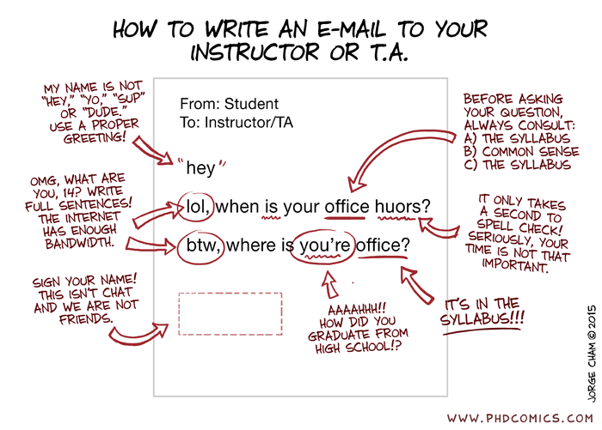

Communication is key.
Use your UP student email for all your communication.
Keep all parties informed regarding potential changes or decisions.
Allow at least 4 days for a response to your e-mail before resending it.
Email Etiquette

Slide 12


After the mobility
Finalizing your mobility documentation to facilitate recognition procedure asap (in 1 month time after your return from Erasmus study exchange).
Upon completion of your Erasmus study exchange, the host institution will issue you a Confirmation of Stay and Transcript of Records.
Submit the Application Form for Recognition along with the required attachments to FAMNIT Referat (via email or in person).
Complete the online report for approval and receipt of remaining Erasmus co-funding.
Get involved with ESN Primorska.
Share your Erasmus experience with others to inspire and encourage future students to participate in similar programs.

Slide 13

Keep in mind that you have ample time to carry out all necessary overlapping tasks.
Do not wait, but act and react.
Create your personal timeline and be well-organized, responsive, attentive and responsible.
Do not be afraid to ask questions and reach out in case of uncertainties.
Presentation Recap
Application procedure at the host institution
Online application for Erasmus co-funding
Completion of the mobility documentation
General preparation

Slide 14

FAMNIT INTERNATIONAL OFFICE
Office Hours: Monday–Friday (9.00–15.00)
*scheduling appointment for your visit is recommendable via email:
international@famnit.upr.si
+386 5 61 17 594

